Slide 1


Marketing Plan: Social Media for The Sparks Foundation (TSF) #task1
By Shweta Kumari

Slide 2
About Sparks Foundation
The Sparks Foundation is a non-profit startup company which was formed in 2016. The Sparks Foundation connect with students of all financial backgrounds with experts, through which knowledge sharing enables equal sharing opportunity to all. TSF helping students from all background to learn and connect with diverse people and help them to get ready to face the real-life challenges confidently.

Slide 3

Program Offered By The Sparks Foundation
Student Scholarship Program
Student Mentorship program
Student SOS program
Workshops
Corporate programs
GRIP

Slide 4
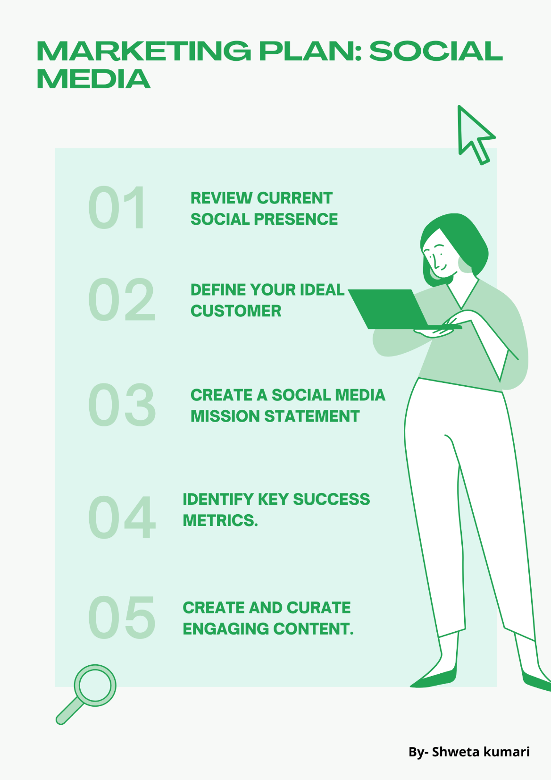

Slide 5
A social media strategy is a summary of everything you intend to do and hope to achieve on social media. In this article, you will learn the seven steps your company should follow to develop an effective social media marketing strategy.
Step 1: Review current social presence
Some of the areas to consider when reviewing your company's social media presence are:
What networks are you currently active on?
Build your profile.
Which networks currently bring you the most value?
How do your profiles compare to those of your competitors?

Slide 6

Step 2: Define your ideal customer
In this step, you should be as specific as possible. Answer the following questions so you can create a specific buyer persona:
Age
Location
Job title
Income
Most used social network

Slide 7
Step 3: Create a social media mission statement.
A social media mission statement will guide your future actions, so think it through. This statement makes it clear what you plan to use your social media presence for and should reflect your brand identity. Think about your ideal customer when formulating this statement. Income

Slide 8
Step 4: Identify key success metrics
Some of the metrics includes:
Conversion rate
Time spent on the website
Reach
Brand mentions
Total shares

Slide 9
Step 5: Create and curate engaging content.
Here are some examples of content you can create:
Images
Videos
Blog posts
Company news
Infographics
E-books

Slide 10
Step 6: Invest in a social media management tool.
When it comes to social media, a social media management tool can help you scale your efforts effortlessly
.
Step 7: Track, analyze and optimize.
This is perhaps the most important step when it comes to social media success. It may sound simple, but tracking results, analyzing data and optimizing are crucial.

Slide 11
Conclusion:
One of the major benefits of DIGITAL MARKETING is that it is highly trackable, that is we can know form where the traffic is coming from to our website and which marketing platform is the most effective.
If we notice the most of our website visitors are coming through facebook links we can focus more on post regular contents on facebook some goes with other platforms and website. Most used tools is Google Analytics which will help us find exactly which keyboard is bringing visitors on our website and help us optimize our site so that we attract more traffic to our website.

Slide 12
THANK
YOU….

